Slide 1

Ahsanullah University of Science and Technology
Depertment of Computer Science and Engineering
Information System Design & Software Engineering Lab
CSE-3224

Slide 2
Project Name : Car rental System
Submitted By
Jebin Tasnim ID:14.01.04.056
Redwanul Rahman ID:14.01.04.058
Muntasir Mamoor ID:14.01.04.072
Fatin Noor Anik ID:14.01.04.073

Slide 3
Why Car rental system?
most of the people don’t have their own car so face transportation problem when they want to travel with their family. In marriage ceremony program people face this transportation problem .
Besides tourists are also face with this problem in tourist spot.
CAR RENTAL SYSTEM apps reduce all this transportation problem and it helps minimize time and cost efficiently.

Slide 4
Project summery
Enhanced Business Process
Online vehicle Reservation
Customer’s Registration
Group Booking

Slide 5
Project requirement
Programming Language: PHP, HTML, JavaScript,ASP.net
Style: CSS
IDE: Bracket, MS Visual Studio
Database: PHP MyAdmin
Operating System: Windows 10

Slide 6
Data flow diagram

Slide 7
Activities of our project
Booking Order
Car Order
Pay for Booking
Provide Car
Garage
Order Parts/ New Car
Pay for Parts/ New Car
Pay for Employee

Slide 8
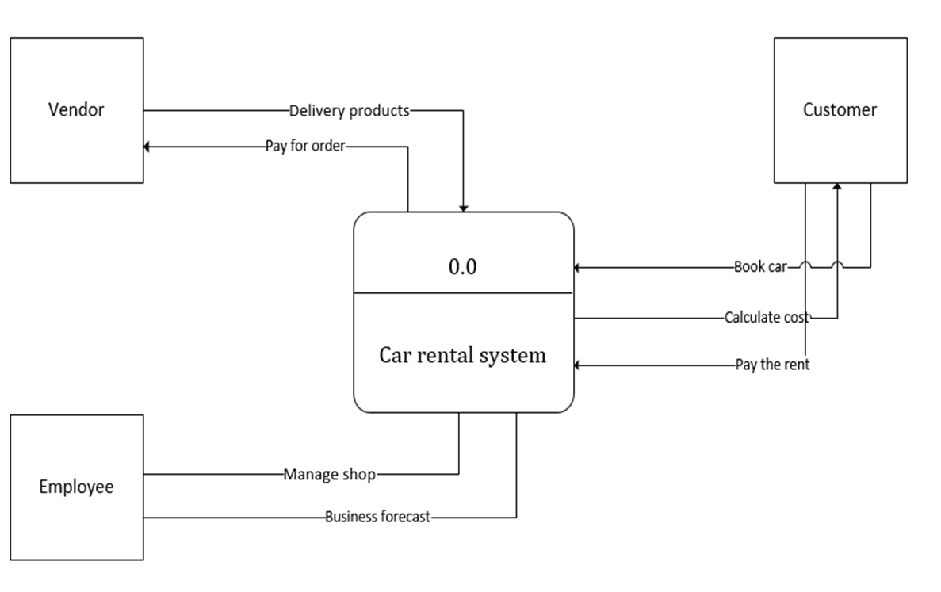
Context level diagram

Slide 9
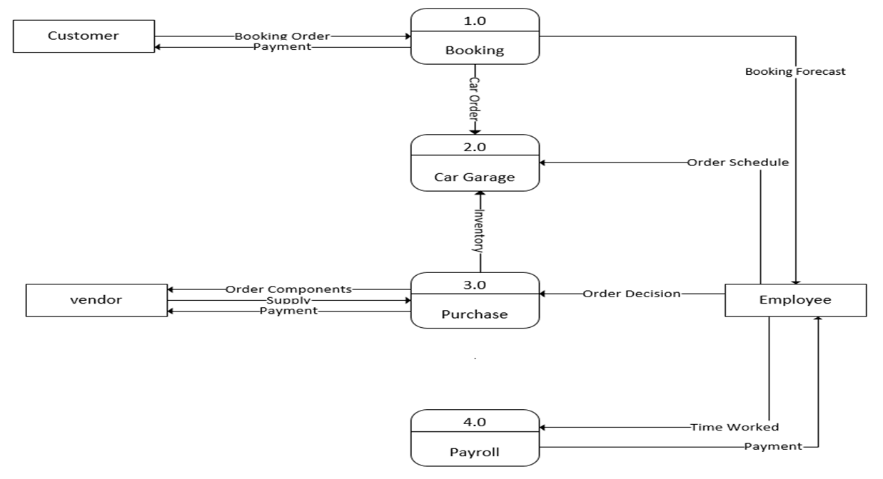
Level 0 diagram

Slide 10
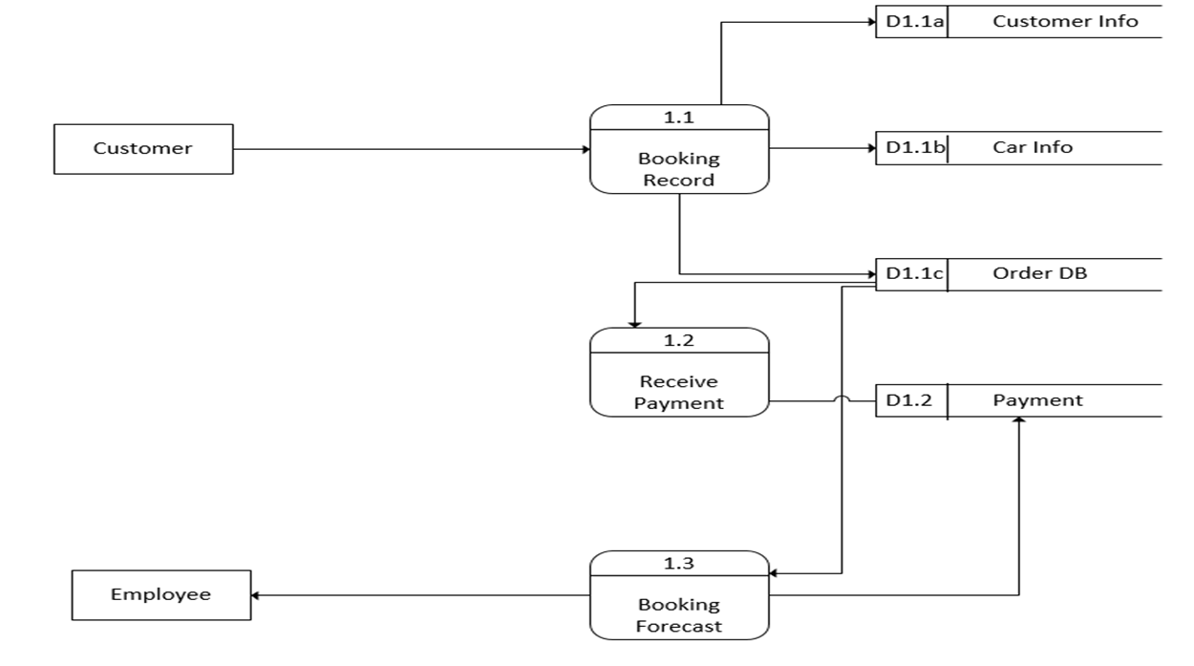
Level 1 diagram

Slide 11
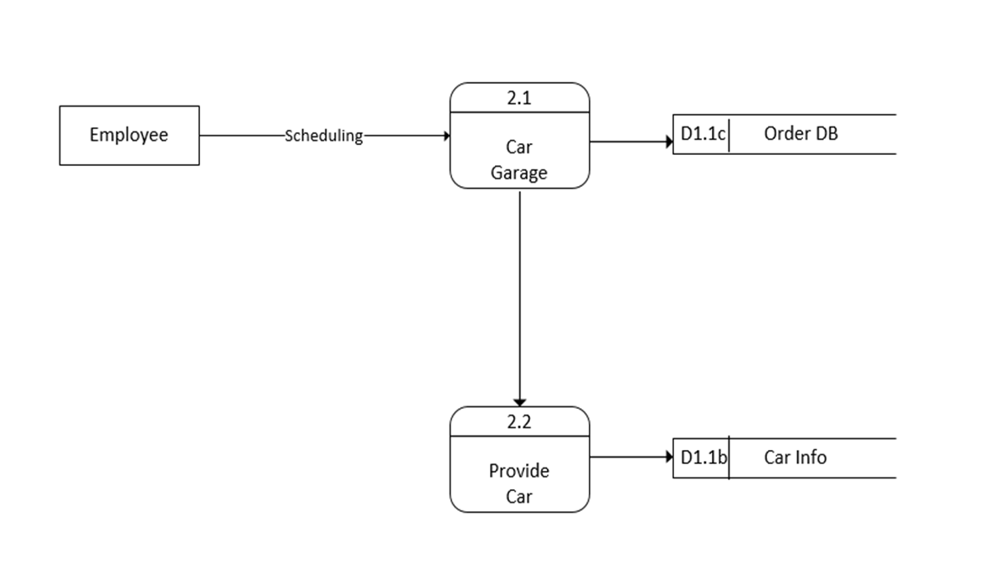
Level 1 diagram

Slide 12
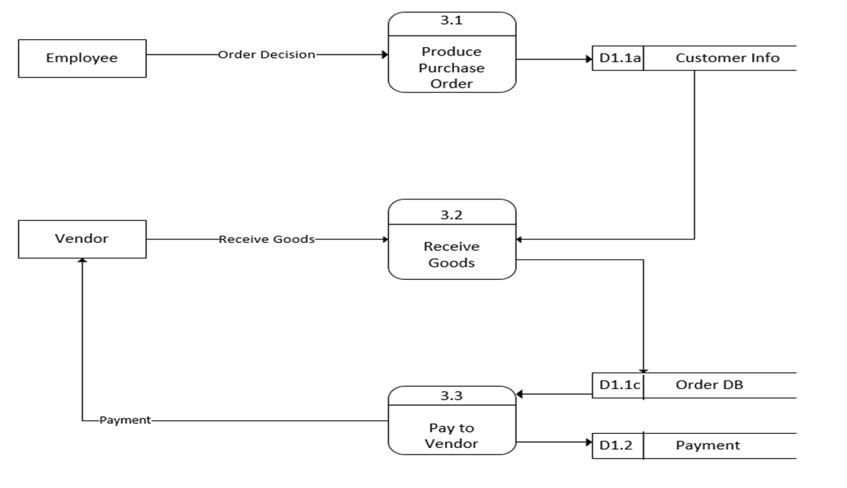
Level 1 diagram

Slide 13
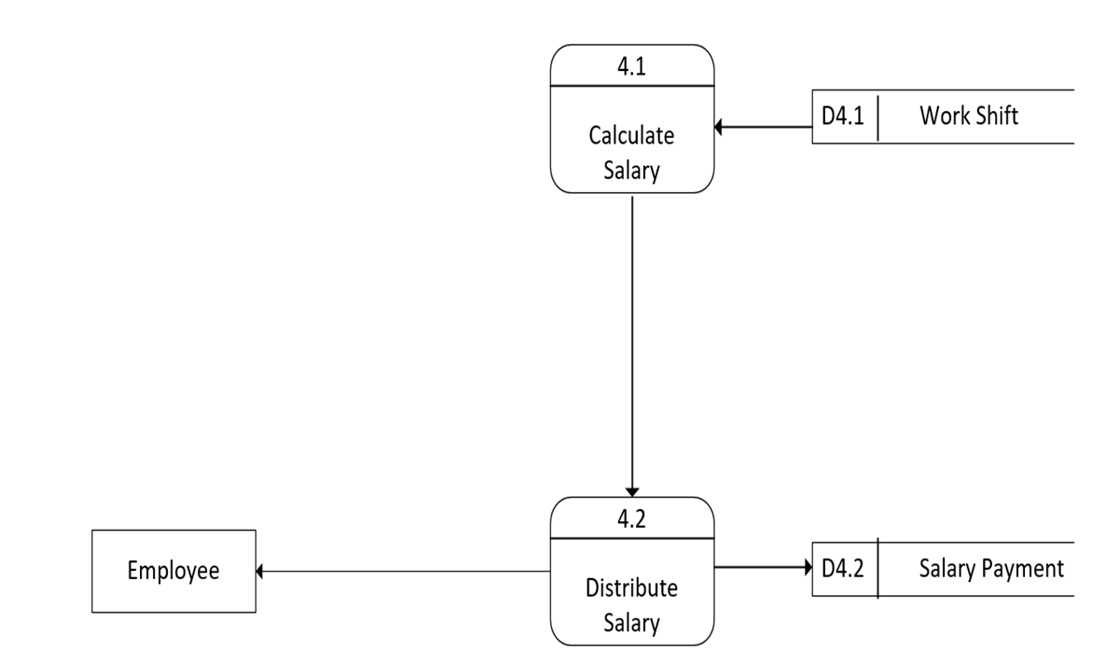
Level 1 diagram

Slide 14
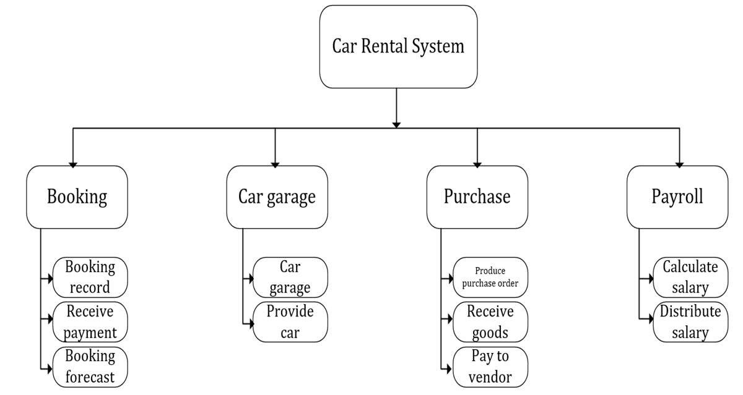
Process decomposition

Slide 15
actor
Customer
System
Employee

Slide 16
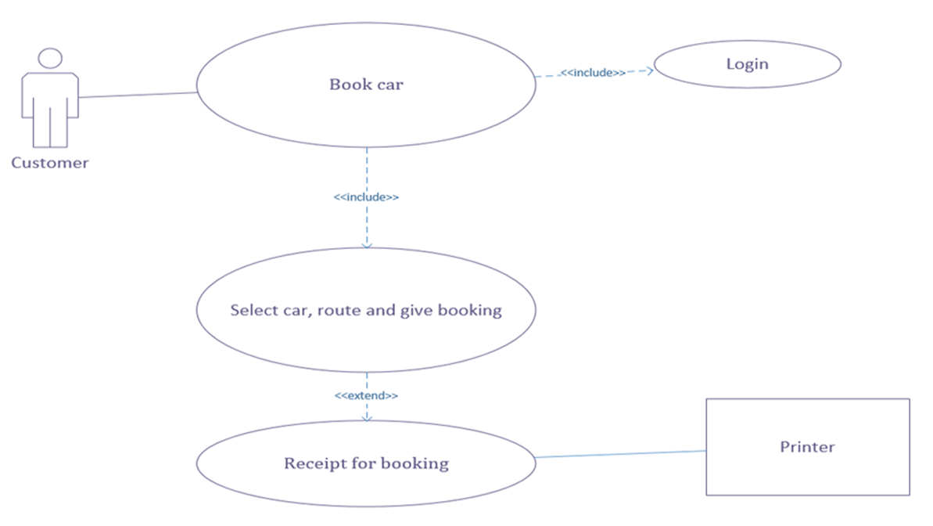
Use case diagram

Slide 17
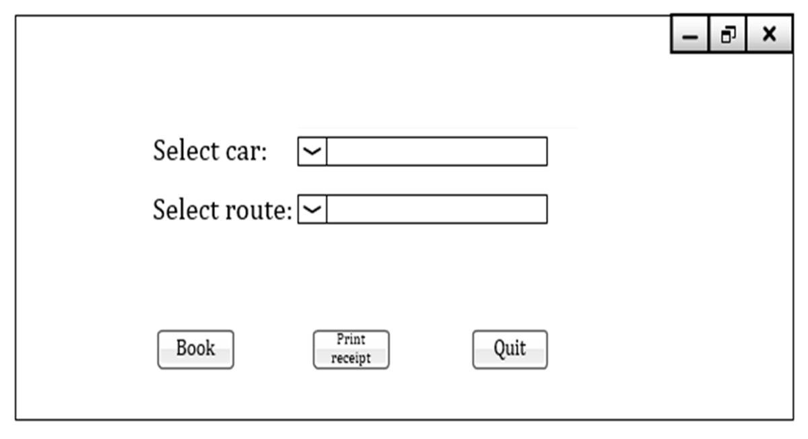
Gui for use case diagram

Slide 18
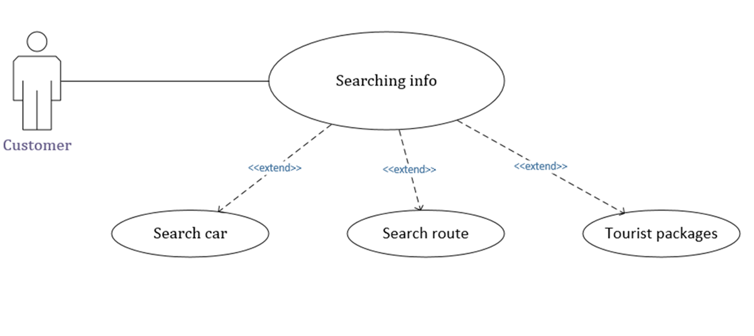
Use case diagram

Slide 19
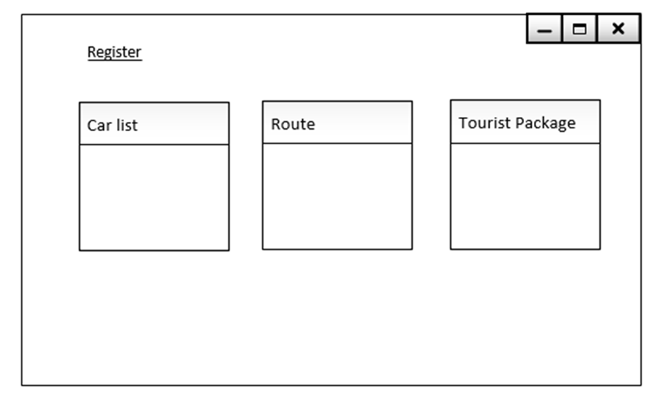
Gui for use case diagram

Slide 20
entity relationship diagram

Slide 21
Entity set names
Rent
Customer
Owner
Car
Route Name
Package

Slide 22
Attributes with data types
Attributes of Rent:
Rent_Id int(11)
Package Id varchar(50)
Customer Id varchar(50)
Attributes of Customer:
Customer Id int(11)
Customer Name varchar(50)
Address varchar(50)
Customer Phone varchar(50)
Email varchar(50)
Password varchar(50)

Slide 23
Attributes with data types
Attributes of Owner:
Owner_Id int(11)
Name varchar(50)
Address varchar(50)
Phone int(11)
Email varchar(50)
Password varchar(50)
Attributes of Car:
Car Id int(11)
Car Name varchar(50)
Model varchar(50)
OwnerId int(11)

Slide 24
Attributes with data types
Attributes of Route:
RouteId int(11)
Source varchar(50)
Destination varchar(50)
Attributes of Package:
Package Id int(11)
Name varchar(50)
Price int(11)
Car_Id int(11)
RouteId int(11)

Slide 25
Attributes with symbols
Simple Attribute:
Composite Attribute:
Derived Attribute:
Multivalued Attribute:
( )

Slide 26
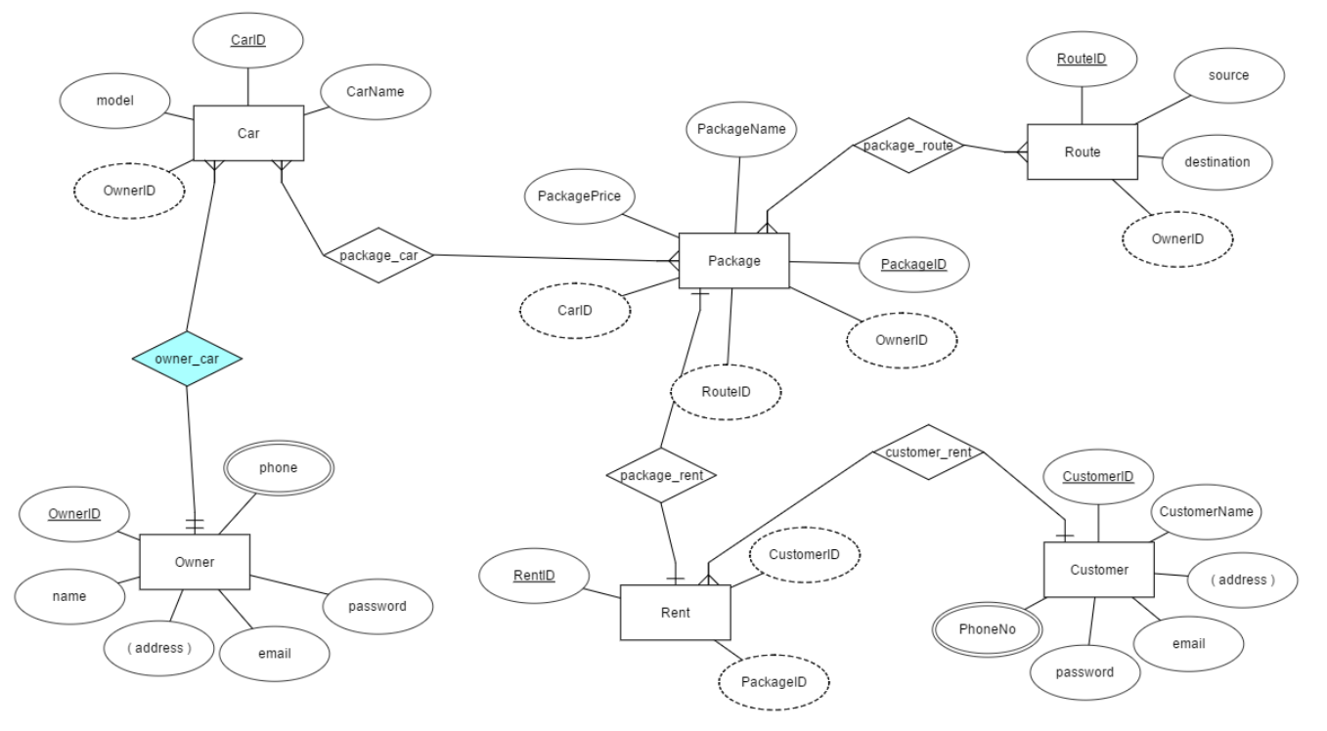
Entity relationship diagram

Slide 27
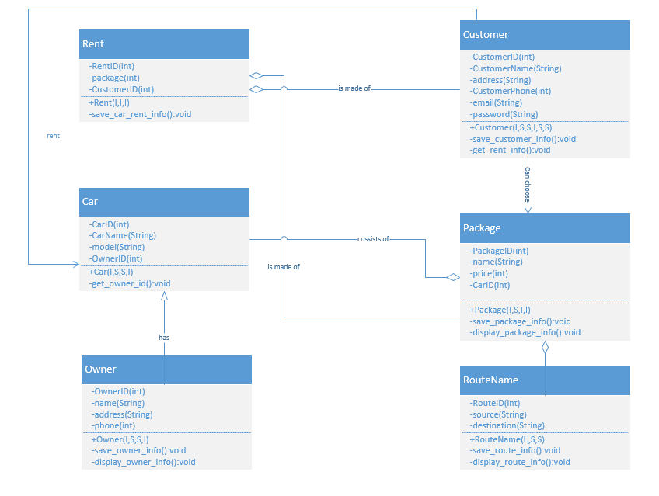
Class diagram

Slide 28
Future plan
As the software is not fully completed (80% completed), in the future we will complete the software.
Will make our website responsive for every media.
Some more features will be added.
We will create an android application.
Opportunities for the best customers will be provided by the software.
Monthly newsletter will be provided via mail to the customer regarding new offer and other news.

Slide 29


Slide 30


